Slide 1
Organization of Knowledge Framework and Forward Model 07/24 YU LI

Slide 2



Working principle of CW pulse oximetry
dMBLL:
∆µa: the change in absorption coefficients
Lj :the expected partial path length in the jth tissue

Slide 3
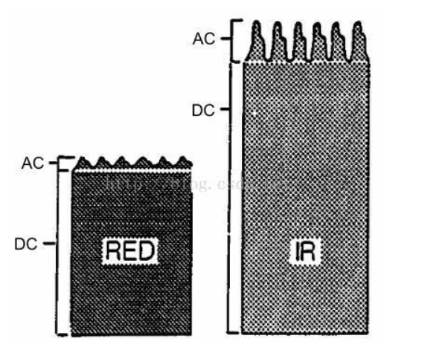


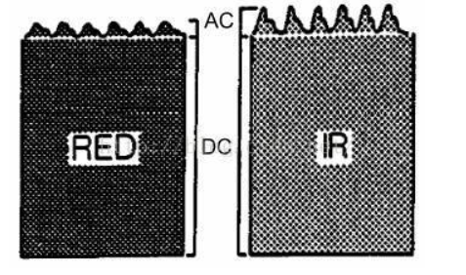
Working principle of CW pulse oximetry
AC/DC and SpO2：
A scaling transformation is required.

Slide 4
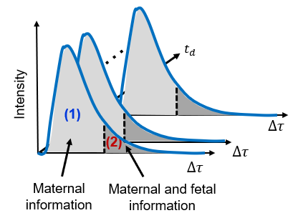
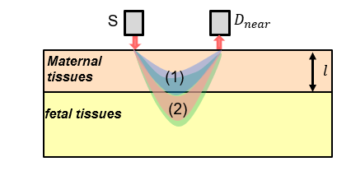
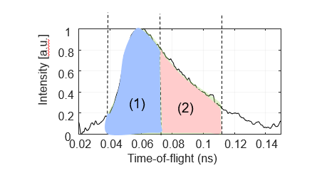
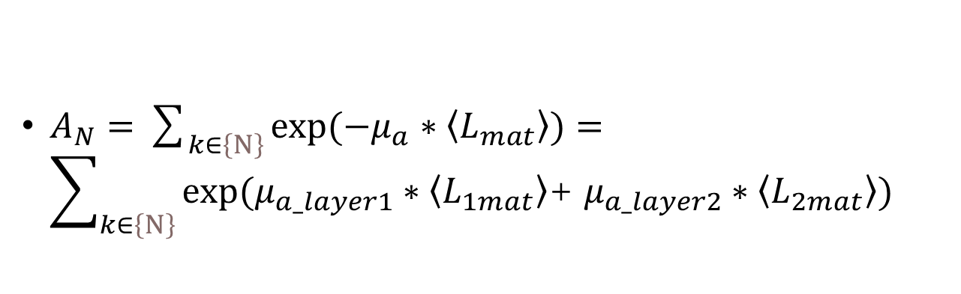
Forward model: obtain raw measurement from TOF curve
$A_{N}=\sum_{k∈\left\{N\right\}}{exp⁡(−μ_{a}∗\left\langle L_{mat}\right\rangle )}=\sum_{k∈\left\{N\right\}}{exp⁡(μ_{a_layer1}∗\left\langle L_{1mat}\right\rangle \text{+} μ_{a_layer2}∗\left\langle L_{2mat}\right\rangle )}$

Slide 5
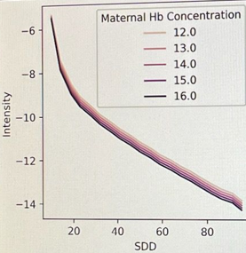
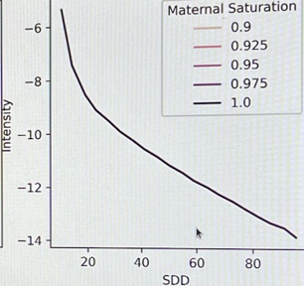
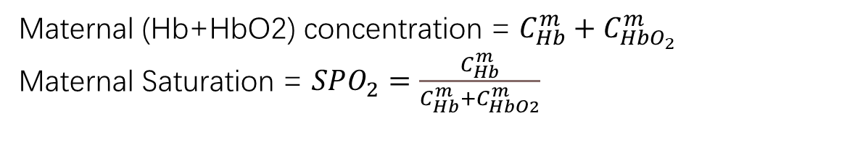
Simple μa measurment
Maternal (Hb+HbO2) concentration = $C_{Hb}^{m}+C_{HbO_{2}}^{m}$
Maternal Saturation = $SPO_{2}=\frac{C_{Hb}^{m}}{C_{Hb}^{m}+C_{HbO2}^{m}}$

Slide 6
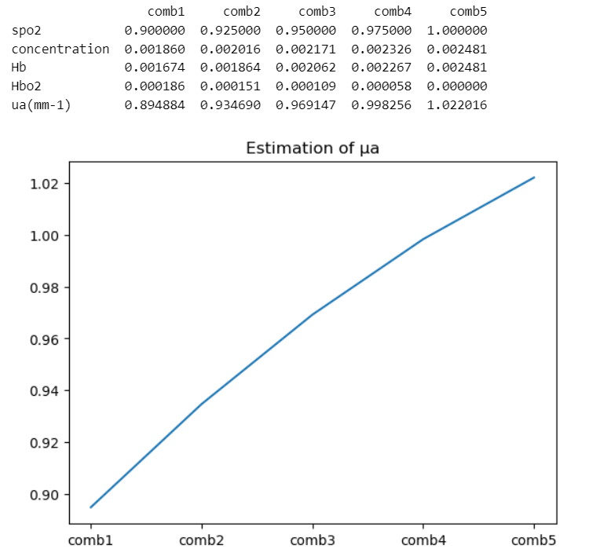
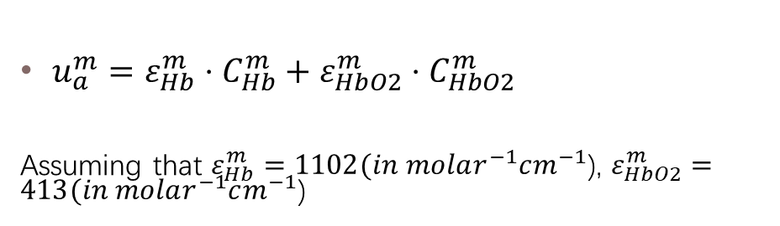
Simple μa measurment
$u_{a}^{m}=ε_{Hb}^{m}⋅C_{Hb}^{m}+ε_{HbO2}^{m}⋅C_{HbO2}^{m}$
Assuming that $ε_{Hb}^{m}=\text{11}02(in molar^{−1}cm^{−1}$), $ε_{HbO2}^{m}=\text{413}(in molar^{−1}cm^{−1}$)
The peak value of μa here is 1.022, and the valley value is 0.895.

Slide 7
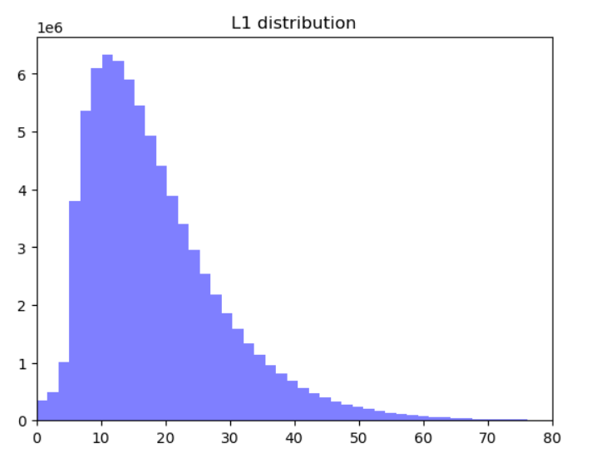
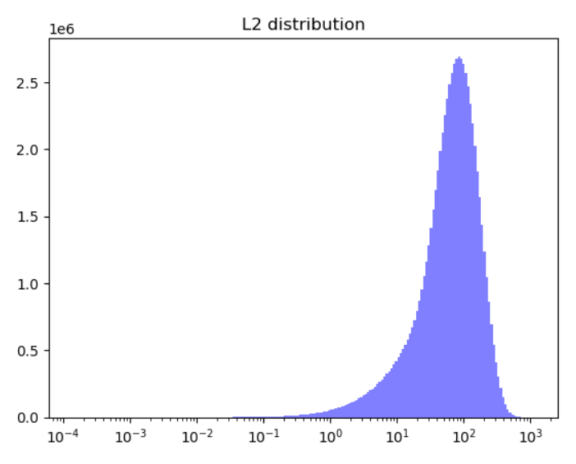
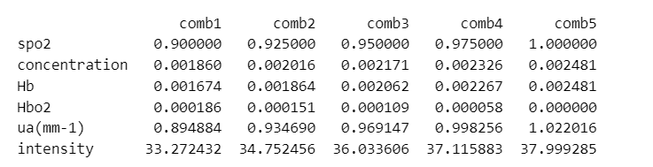
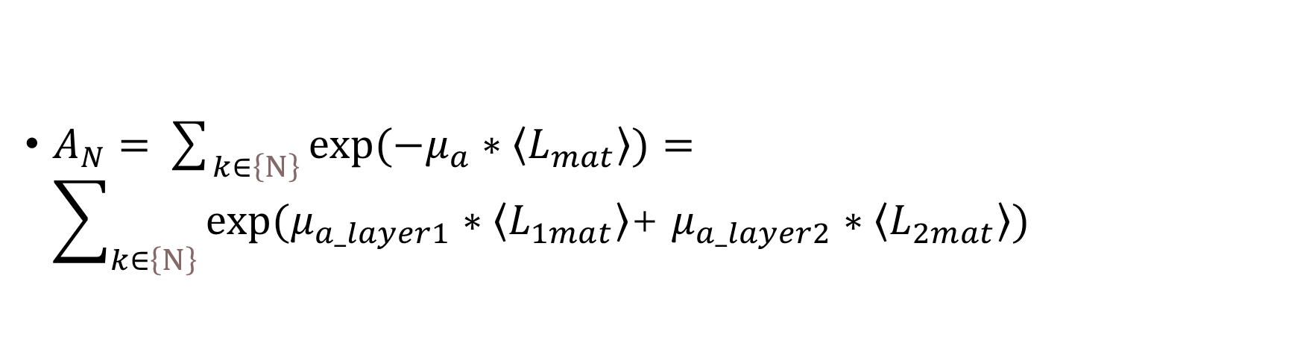
Beating signals
$A_{N}=\sum_{k∈\left\{N\right\}}{exp⁡(−μ_{a}∗\left\langle L_{mat}\right\rangle )}=\sum_{k∈\left\{N\right\}}{exp⁡(μ_{a_layer1}∗\left\langle L_{1mat}\right\rangle \text{+} μ_{a_layer2}∗\left\langle L_{2mat}\right\rangle )}$

